Slide 1
Intro to Assembly Language
Muhammad Tasnim mohiuddin
Lecturer, cse, uiu

Slide 2
Levels of Programming Languages
1) Machine Language
2) Assembly Language (Low Level Language)
3) High Level Languages

Slide 3
Machine Language
Set of fundamental instructions
Native to a processor: executed directly by hardware
Expressed as a pattern of 1’s and 0’s
Here’s what a program-fragment looks like:
10100001 10111100 10010011 00000100
00001000 00000011 00000101 11000000
10010011 00000100 00001000 10100011
11000000 10010100 00000100 00001000
It means: z = x + y;

Slide 4
Assembly Language
One step up from machine language
Designed for a specific family of processors (different processor groups/family has different Assembly Language)
Consists of symbolic instructions directly related to machine language instructions one-for-one and are assembled into machine language.
Alphanumeric equivalent of machine language
Mnemonics more human-oriented than 1’s and 0’s
Example: for A = A + 4
MOV AX, A
ADD AX, 4
MOV A, AX

Slide 5
High Level Languages
Similar to Natural language.
Designed to eliminate the technicalities of a particular computer.
Statements compiled in a high level language typically generate many low-level instructions.
Example: C, Java, Python etc

Slide 6
Advantages of High-Level Languages
Program development is faster
High-level statements: fewer instructions to code
Program maintenance is easier
For the same above reasons
Programs are portable

Slide 7
Why Assembly Language?
Accessibility to system hardware
Assembly Language is useful for implementing system software
Also useful for small embedded system applications
Faster and shorter programs.
Compilers do not always generate optimum code.
Resident programs (that reside in memory while other program execute) and interrupt service routines (that handle input and output) are almost always develop in Assembly Language.
Instruction set knowledge is important for machine designers.
Compiler writers must be familiar with details of machine language.

Slide 8
Advantages of Assembly Language
Shows how program interfaces with the processor, operating system, and BIOS.
Shows how data is represented and stored in memory and on external devices.
Clarifies how processor accesses and executes instructions and how instructions access and process data.

Slide 9
Assembler
An assembler is a program that converts source-code programs written in assembly language into object files in machine language
Popular assemblers have emerged over the years for the Intel family of processors. These include …
TASM (Turbo Assembler from Borland)
NASM (Netwide Assembler for both Windows and Linux), and
GNU assembler distributed by the free software foundation

Slide 10
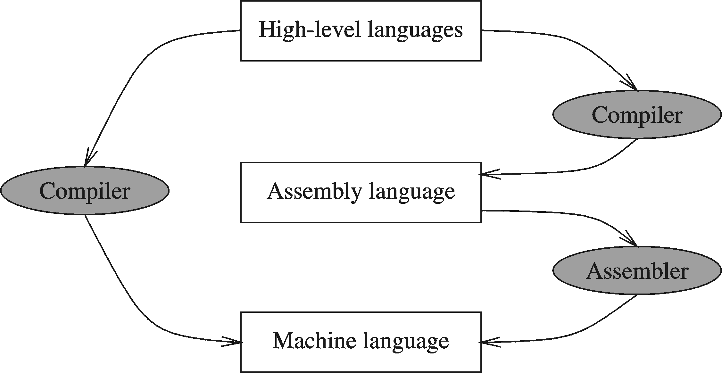
Compiler and Assembler

Slide 11
Computer Architecture
Memory
CPU
I/O Devices

Slide 12
Computer Architecture
Address Bus
CPU
Memory
I/O
Control Bus
Data Bus

Slide 13
Organization of 8086 Processor
16 bit Processor
16 bit data bus
16 bit registers
20 bit Address bus

Slide 14
Organization of 8086 Processor
CPU-Memory Interface
Address Bus
CPU
Memory
20
Data Bus
16-bit
16
Control Bus

Slide 15
Bytes and Words
Information processed by computer is stored in its memory
A memory element can store one bit of data
Group of 8 bits forms one byte
Group of 16 bits or 2 bytes forms one word

Slide 16
RAM and ROM
Random-Access Memory (RAM)
Can be performed read and write operation
Program instruction and data are loaded into RAM
Contents are lost when the machine is turned off
ROM (Read-Only-Memory)
Once initialized can’t be changed, can only be read
Retain values event the machine is turned off
Hence used to store system programs

Slide 17
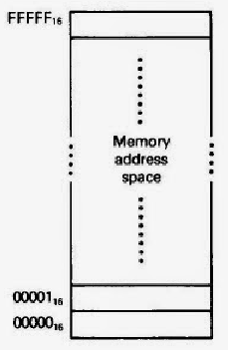
Address Space of 8086

Slide 18
Number System

Slide 19
Number System
Consists of TWO Things:
A BASE or RADIX Value
A SET of DIGITS
Digits are symbols representing all values less than the radix value.
Example is the Common Decimal System:
RADIX (BASE) = 10
Digit Set = {0, 1, 2, 3, 4, 5, 6, 7, 8, 9}

Slide 20
Decimal Number Systems
Consider: 5032.21
5032.21

Slide 21
Commonly Occurring Bases
Binary
Radix = (2)₁₀
Digit Set = {0,1}
Octal
Radix = (8)₁₀
Digit Set = {0,1,2,3,4,5,6,7}
Hexadecimal
Radix = (16)₁₀
Digit Set = {0,1,2,3,4,5,6,7,8,9,A,B,C,D,E,F}

Slide 22
Any Base to Decimal
A number with radix r is represented by a string of digits:
A_{n - 1}A_{n - 2} … A₁A₀ . A₋ ₁ A₋ ₂ … A_{- m + 1} A_{- m}
The string of digits represents the power series:
i = n - 1
j = - m
(Number)_{r}
=
∑
i
+
∑
j
A
r
A
r
i
j
i = 0
j = - 1
(Integer Portion)
(Fractional Portion)
+

Slide 23
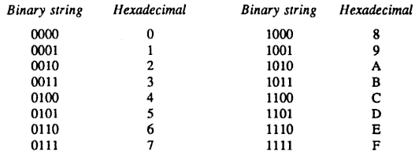
Hexadecimal
16-base number system
16 symbols (0—9, A, B, C, D, E, F)
Again radix is power of 2
4 bits to represent a hexadecimal number

Slide 24
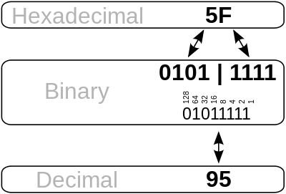
Hexadecimal to Binary
Restate the hexadecimal as four binary digits starting at the radix point and going both ways.

Slide 25
Binary to Hexadecimal
Group the binary digits into four bits groups starting at the radix point and going both ways, padding with zeros as needed in the fractional part.
Convert each group of three bits to an hexadecimal digit.

Slide 26
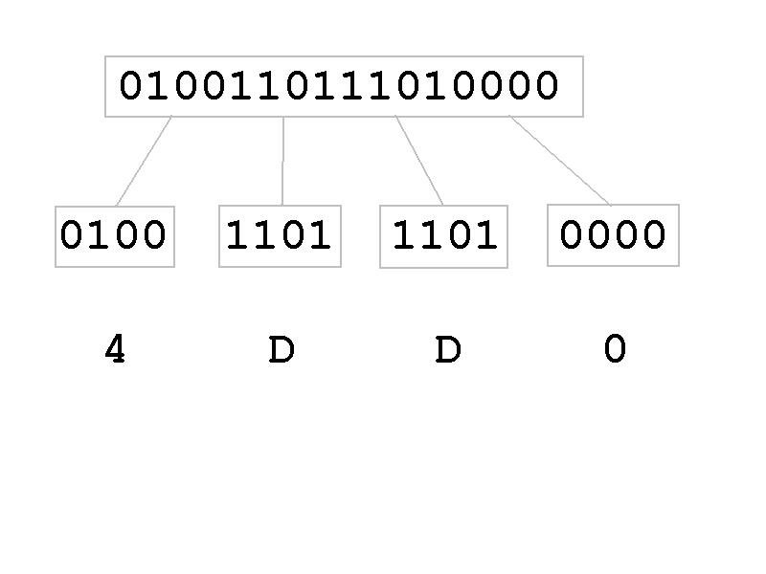
Binary to Hexadecimal

Slide 27
Binary Negative Numbers
In decimal we are quite familiar with placing a
“-” sign in front of a number to denote that it is negative
But for binary numbers a computer won’t understand that
What happens in memory then?

Slide 28
Binary Negative Numbers
There are several representations
- Signed magnitude
- One’s complement
- Two’s complement

Slide 29
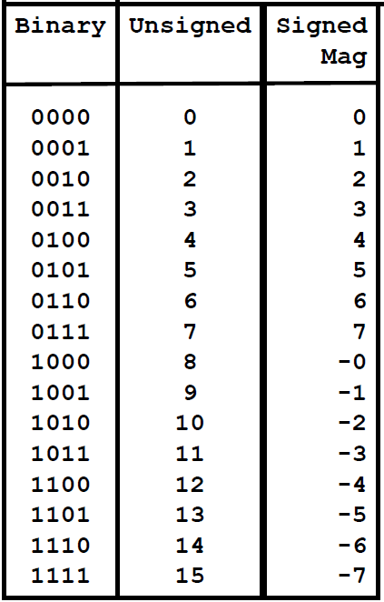
Signed Magnitude
Left bit (MSB) used as the sign bit

Slide 30
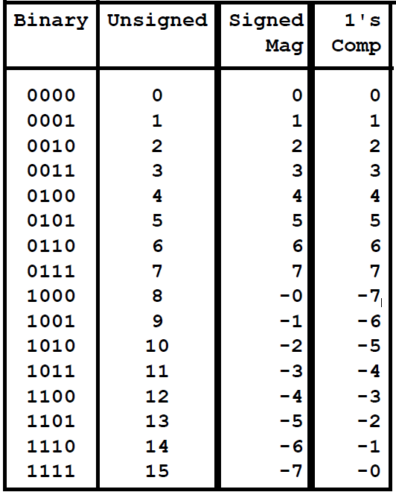
One’s Complement
Invert the ones and zeros

Slide 31
Subtraction with One's Complement
Steps for subtracting x from y with an n-bit 1's complement representation:
Negate x using 1's complement.
Add -x and y.
If the sum exceeds n bits, add the extra bit to the result.
If the sum does not exceed n bits, leave the result as it is.
The result will be in 1's complement form

Slide 32




Example: subtracting 1 from 7 using 1's complement
First, we need to convert 0001 to its negative equivalent in 1's complement.
Next we perform addition of 7 and our computed 1's complement of -1.
Notice that our addition caused an overflow bit. Whenever we have an overflow bit in 1's complement, we add this bit to our sum to get the correct answer. If there is no overflow bit, then we leave the sum as it is.

Slide 33
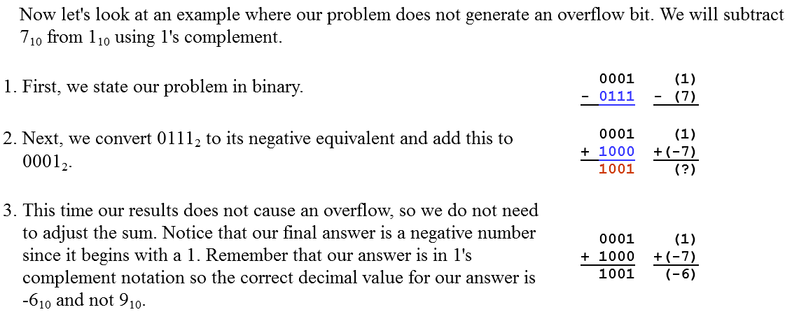
Another Example

Slide 34
Two’s Complement
Take 1’s complement then add 1
OR
Toggle all bits to the left of the first ‘1’ from the right
Example:
1 0 1 1 0 0 0 0
0 1 0 0 1 1 1 1
+ 1
1 0 1 1 0 0 0 0
0 1 0 1 0 0 0 0
0
1
0
1
0
0
0
0

Slide 35
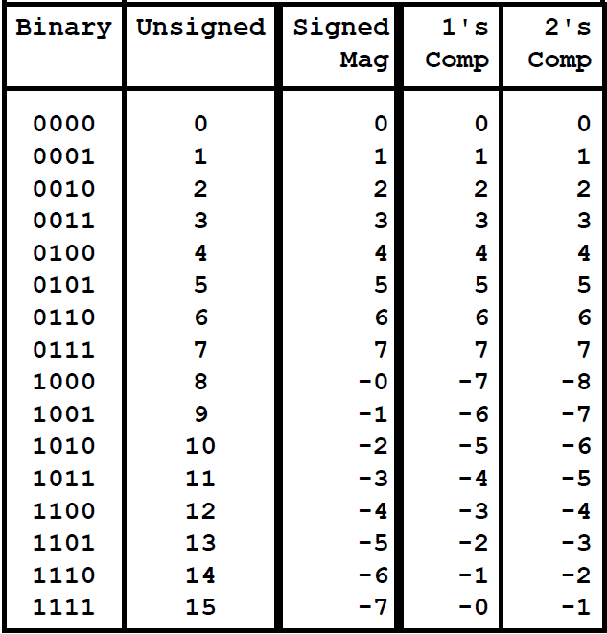
Two’s Complement

Slide 36
Subtraction with Two’s Complement
Steps for subtracting x from y with an n-bit 2's complement representation:
Negate x using 2's complement.
Reverse all the bits in x.
Add 1 to form -x.
Add -x and y.
Discard any bits greater than n.
The result will be in 2's complement form

Slide 37



Example: subtracting 1 from 7 using 2's complement
First, we need to convert 0001₂ to its negative equivalent in 2's complement.
Next we perform addition of 7 and our computed 2's complement of -1.
Notice that our addition caused an overflow bit. Whenever we have an overflow bit in 2's complement, we discard the extra bit. This gives us a final answer of 0110₂ (or 6₁₀)

Slide 38
Another Example
1 -7 = 1 + (-7)
0001
+1001
1010
2’s complement of -7
1010 is the 2’s complement of -6

Slide 39
Registers of 8086
Intel 8086 contains following registers:
General Purpose Registers
Pointer and Index Registers
Segment Registers
Instruction Pointer
Status Flags

Slide 40
General Purpose Registers
There are four 16-bit general purpose registers:
Accumulator Register (AX)
Base Register (BX)
Count Register (CX)
Data Register (DX)

Slide 41
Pointer & Index Register
Following four 16-bit registers are under this category:
Stack Pointer (SP)
Base Pointer (BP)
Source Index (SI)
Destination Index (DI).

Slide 42
Segment Register
There are four 16-bit segment registers in Intel 8086:
Code Segment Register (CS),
Data Segment Register (DS),
Stack Segment Register (SS),
Extra Segment Register (ES).

Slide 43
Rest 2 Registers
Instruction Pointer
Status Flag Register

